Slide 1

Data, data and more data: Strategies for handling data on Microsoft Azure
David Gristwood
Technical Evangelist
David.Gristwood@Microsoft.com

Slide 2
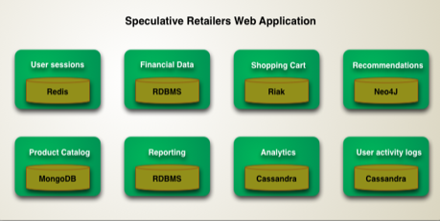
Polyglot Persistence
Different databases are designed to solve different problems. Using a single database engine for all of the requirements usually leads to non-optimal solutions
“Increasingly we see applications manage their own data using different technologies depending on how the data is used…. this will come at a cost in complexity. Each data storage mechanism introduces a new interface to be learned…”
* Don't take the example in the diagram too seriously. I'm not making any recommendations about which database technology to use for what kind of service. But I do think that people should consider these kinds of technologies as part of application architecture.
Martin Fowler*

Slide 3
Data on the cloud – high level trends
Relational, ACID,
Line of Business, etc
Miscellaneous telemetry,
logs, documents, etc

Slide 4
Data on Azure
VMs
Azure
storage
Relational database as a Service
NoSQL as a Service
Hadoop
Cache
Search

Slide 5
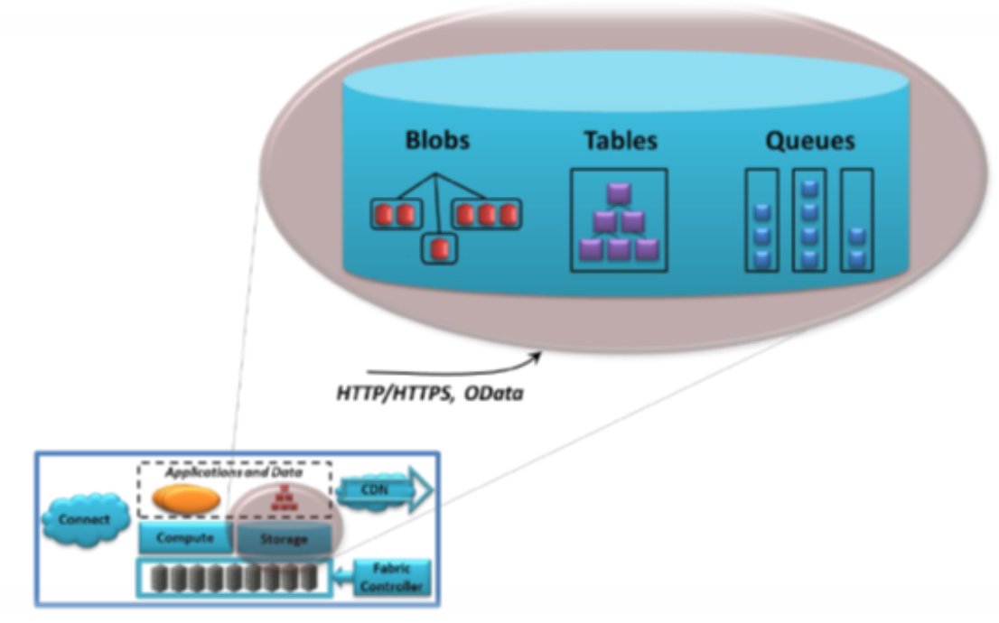
Azure Storage
Azure Storage is the cloud storage solution for modern applications that rely on durability, availability, and scalability. It is highly scalable, elastic, globally accessible, and automatically load-balances your data based on traffic
Massively scalable, store and process hundreds of terabytes of data to support the data scenarios required by scientific, financial analysis, and media applications, etc.
or small amounts of data required for a small business website
Rest based access
Max 500 TB per storage account
20,000 IOPS, entities/sec or messages/sec Total Request Rate per storage account
Notes:
https://docs.microsoft.com/en-gb/azure/storage/storage-table-design-guide

Slide 6
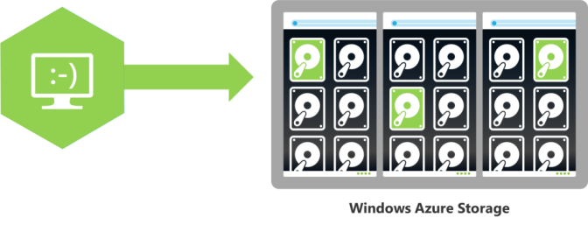
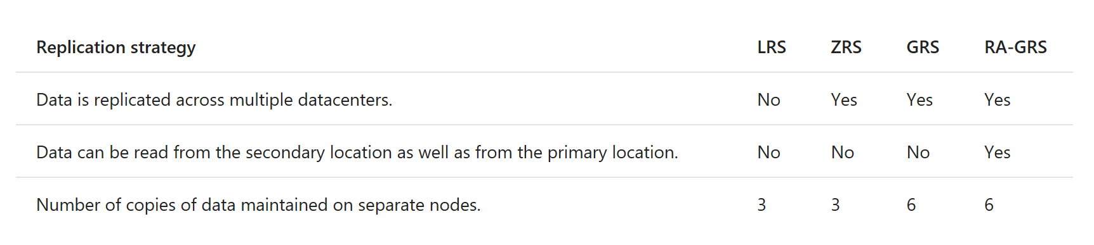
Azure Storage - Replication
Replication options:
Locally redundant storage
Zone-redundant storage
Geo-redundant storage
Read-access geo-redundant storage
Notes:
https://docs.microsoft.com/en-gb/azure/storage/storage-table-design-guide
https://docs.microsoft.com/en-gb/azure/storage/storage-scalability-targets

Slide 7
Azure Storage
Blob Storage stores unstructured object data and can be any type of text or binary data, such as a document, media file, etc.
60 MB/sec or 500 requests/sec target throughput
Hot storage tier optimized for accessed frequently, cool storage infrequently accessed and long-lived
Table Storage stores structured datasets. Table storage is a NoSQL key-attribute data store, which allows for rapid development and fast access to large quantities of data
1 MB max size of entity with a max 255 properties
Single RowKey with additional ParitionKey, 1 KB max size
Queue Storage provides reliable messaging for workflow processing and for communication between components of cloud services
2000 messages/sec target throughput
File Storage offers shared storage for traditional applications using SMB protocol. Azure virtual machines can share file data via mounted shares
5 TB max size of file share, 1 TB max size of a file in a share
60 MB/sec target throughput
Notes:
https://docs.microsoft.com/en-gb/azure/storage/storage-table-design-guide
https://docs.microsoft.com/en-gb/azure/storage/storage-scalability-targets

Slide 8
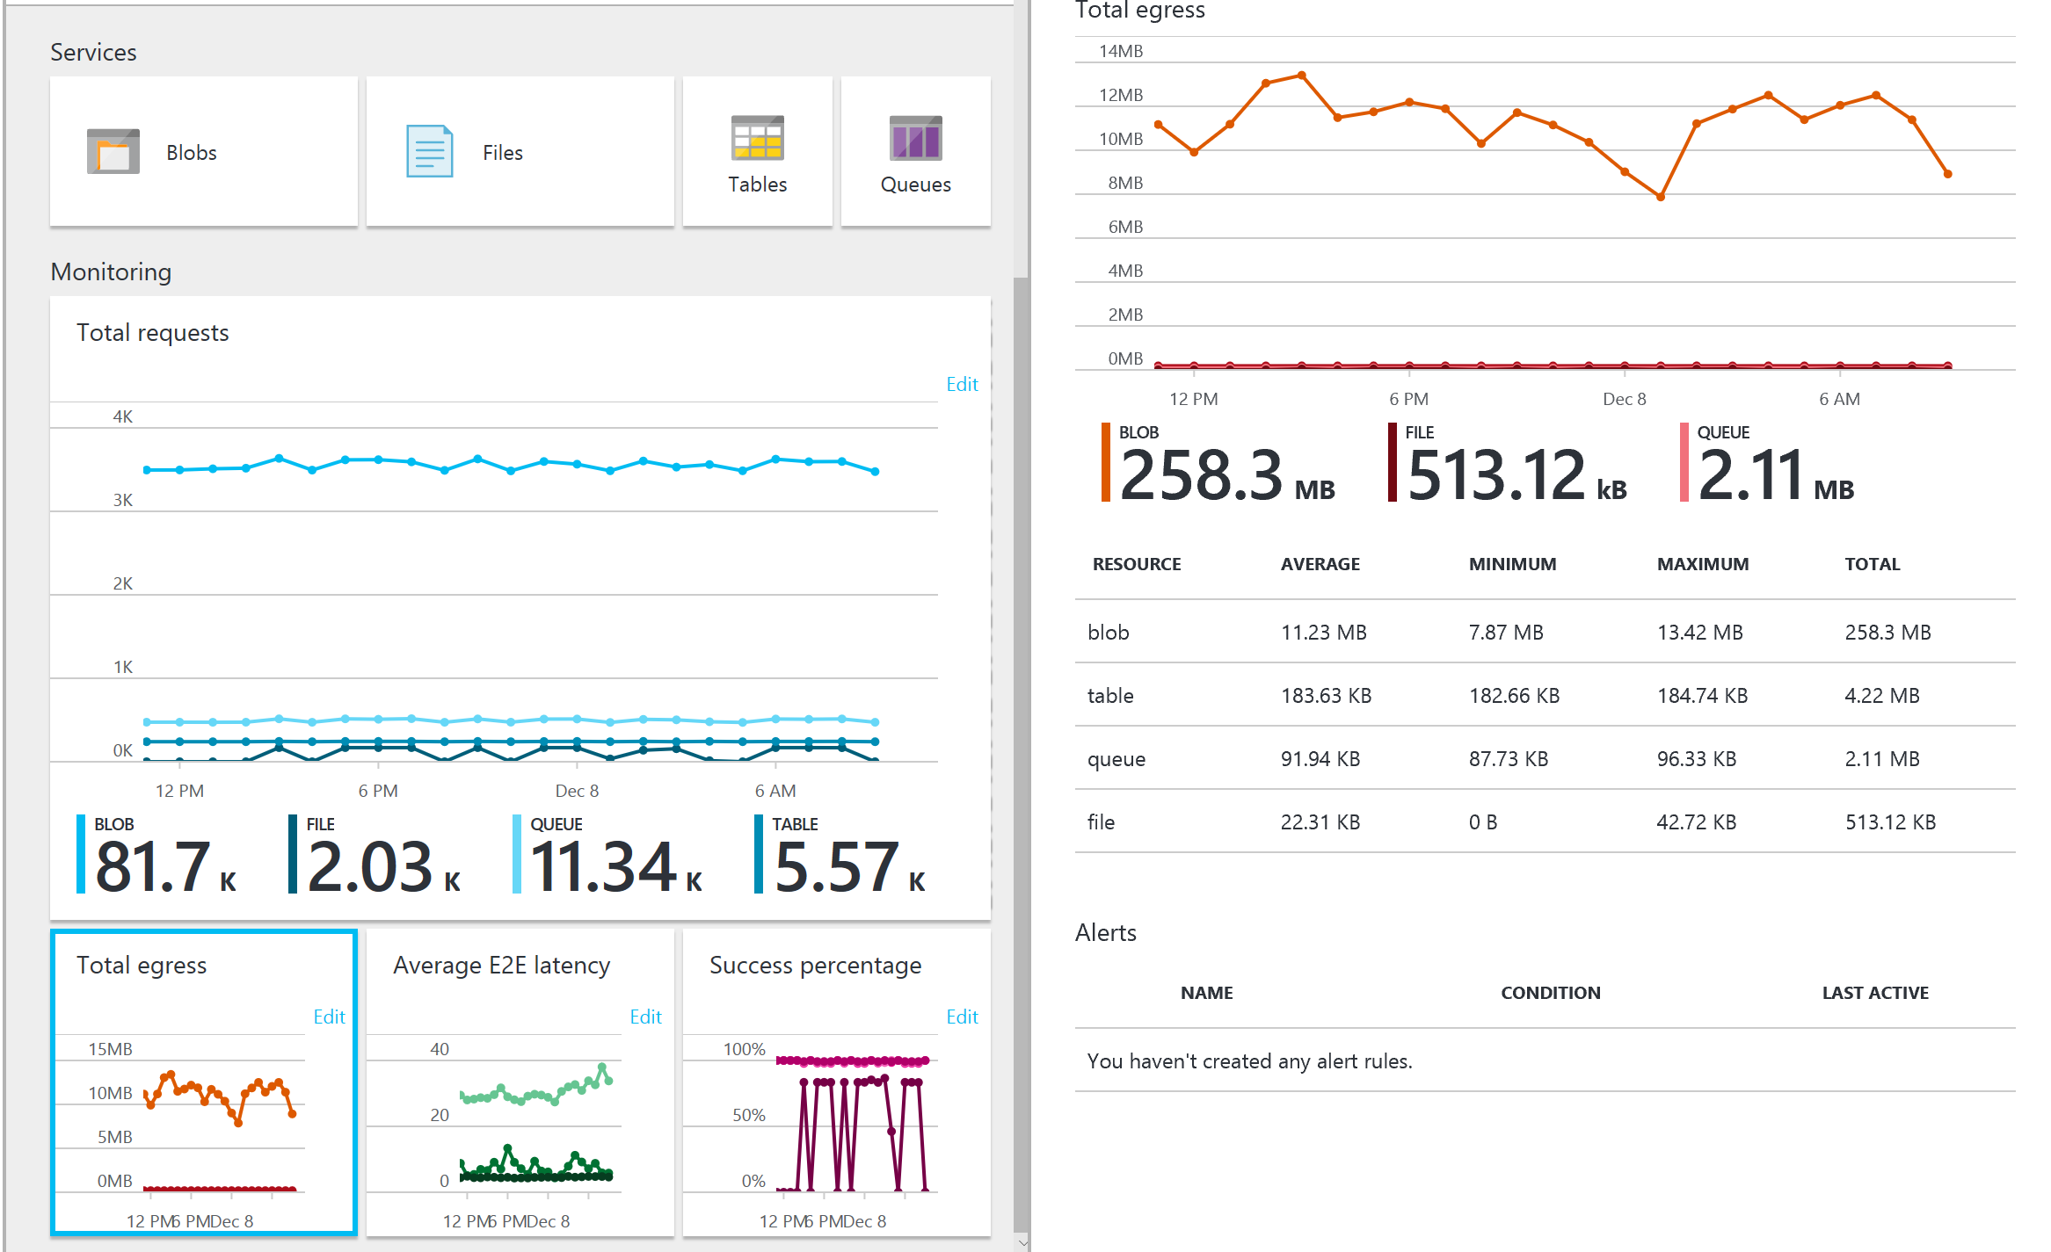
Using the portal to monitor storage accounts

Slide 9
SQL Database
Azure SQL Database is a relational database service with mission-critical capabilities, based on the SQL Server engine, delivering predictable performance, scalability with no downtime, business continuity and data protection, all with minimal administration
Highly compatible V12 engine
Available in three service tiers
Can change on the fly, by creating a replica of the original database at the new performance level
Some transactions in flight may be rolled back, downtime usually under four seconds
Basic: suited for a small database, supporting typically one single active operation at a given time. Examples include databases used for development or testing, or small-scale infrequently used applications
2 GB max database size
30 max concurrent workers / sessions
Standard: go-to option for most cloud applications, supporting multiple concurrent queries
250 GB max database size
200 max concurrent workers / sessions
Premium: Designed for high transactional volume, supporting many concurrent users and requiring the highest level of business continuity capabilities. Examples are databases supporting mission critical applications
1 TB max database size
6400 max concurrent workers / sessions
Notes:
https://docs.microsoft.com/en-us/azure/sql-database/sql-database-scale-up

Slide 10
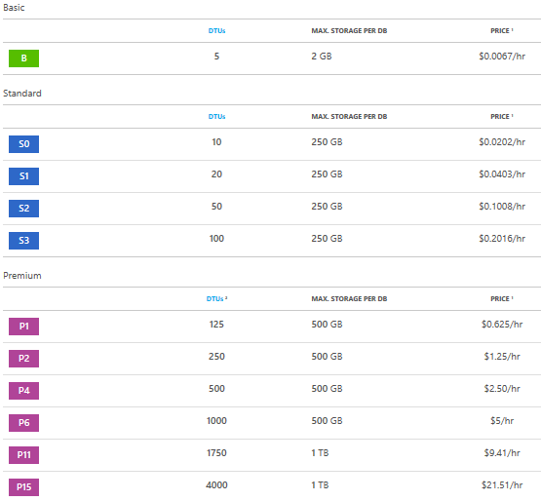
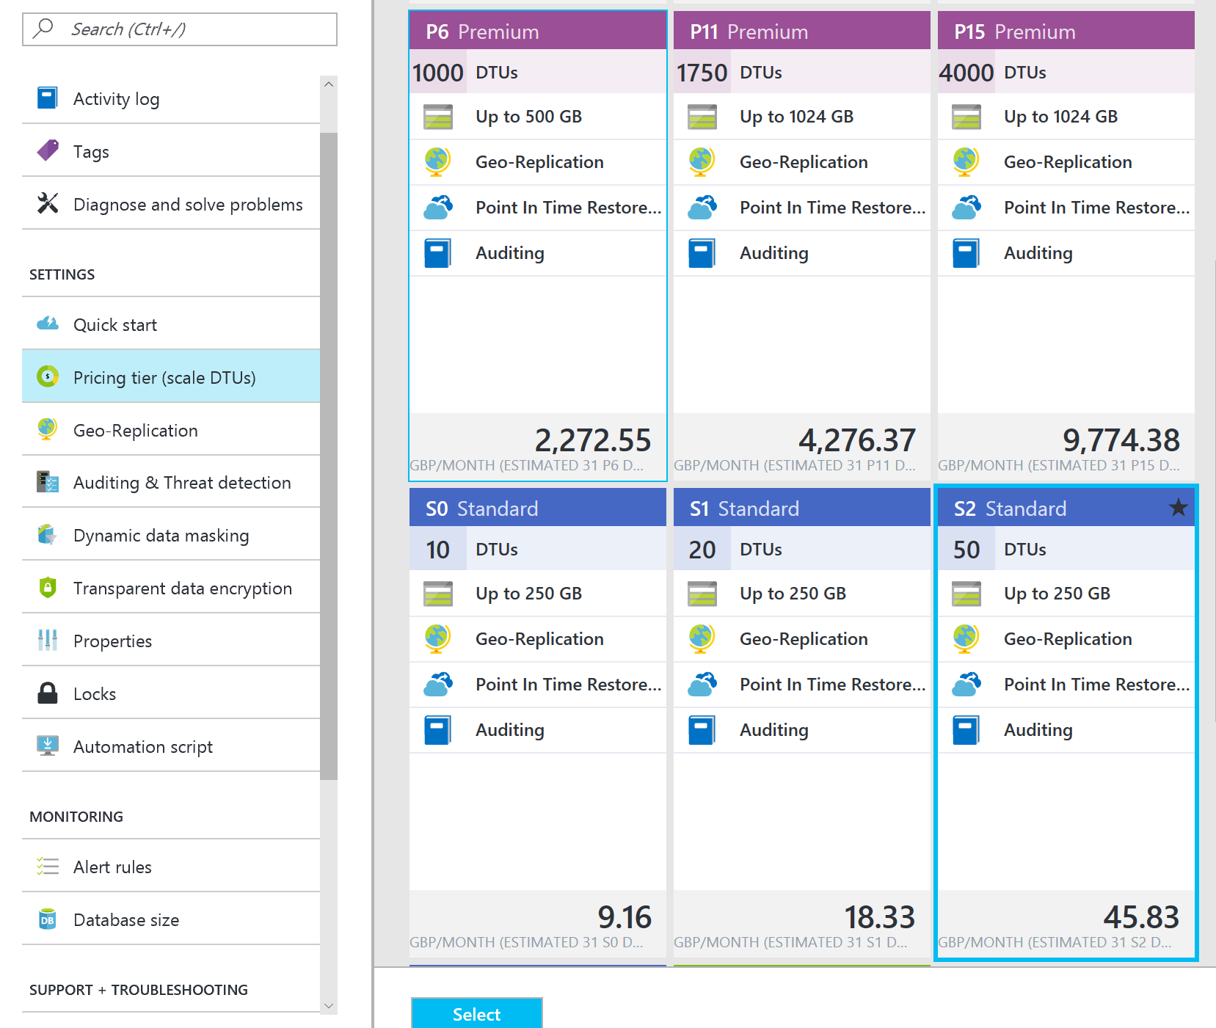
SQL Database – Pricing

Slide 11
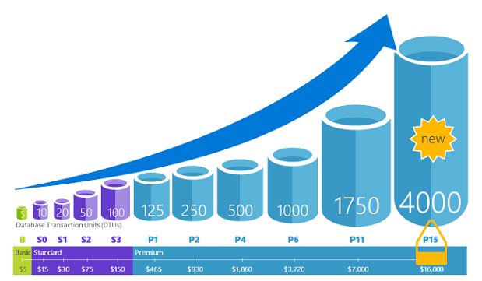
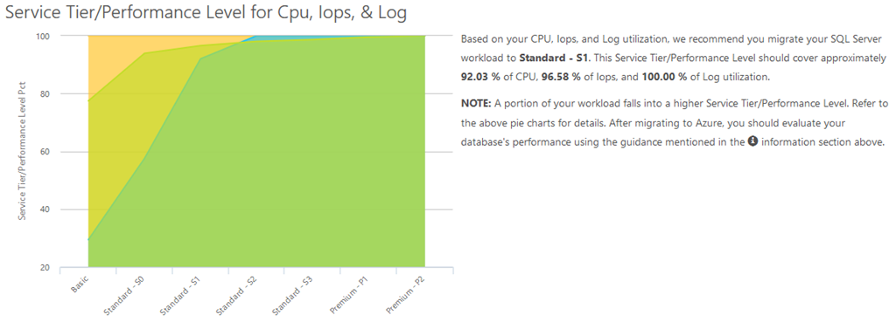
SQL Database – DTUs
Database Transaction Units (DTUs)
measure of CPU, memory, data I/O, transaction log I/O in designed to simulate real-world OLTP workloads
Describes the relative capacity
Azure SQL Database Benchmark (ASDB)
Third party DTU Calculator
dtucalculator.azurewebsites.net

Slide 12
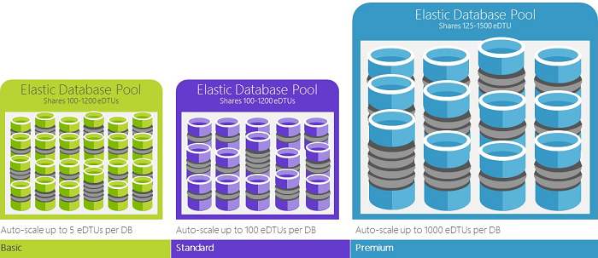
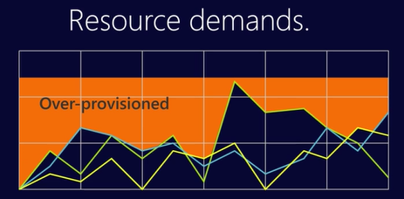
SQL Database – elastic DTUs
Elastic pools provide simple cost effective solution to manage performance goals for multiple databases with varying and unpredictable usage patterns
E.g. multi-tenant solutions using a single-tenant per database
Within the pool, individual databases are given the flexibility to auto-scale within set parameters
Set minimum and maximum DTUs
Avoid auto-provision
Not all single databases are optimum candidates for pools
Notes:
https://docs.microsoft.com/en-us/azure/sql-database/sql-database-elastic-pool
https://docs.microsoft.com/en-us/azure/sql-database/sql-database-elastic-pool-guidance

Slide 13
SQL Database - Business Continuity
Point in Time Restore
Automatic combination of full/weekly/differential database backups hourly, transaction log backups every five minutes
Retention 7 day (Basic), 35 days (Standard/Premium)
Long-Term Backup Retention feature enables storage of backups in an Azure Recovery Services vault for up to 10 years
Or BACPAC to blob storage
In most cases, recovery time is less than 12 hours
Best suited for
Non-mission critical / non binding SLA
Possible lost of data up to one hour
Cost sensitive

Slide 14
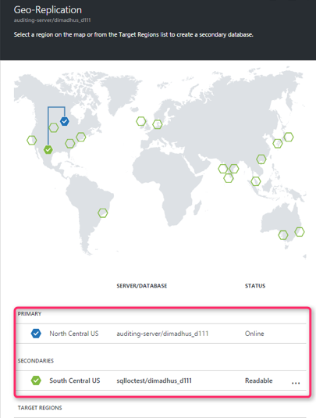
SQL Database - Active Geo-Replication
Active Geo-Replication available in all tiers
Up to four readable secondary databases in the same / different data center locations
Asynchronously replicates committed transactions using read committed snapshot isolation (RCSI) for isolation
Secondary databases for failover for data center outage or inability to connect to the primary database
Offload read-only workloads such as reporting jobs
Notes:
https://docs.microsoft.com/en-us/azure/sql-database/sql-database-geo-replication-overview
https://docs.microsoft.com/en-us/azure/sql-database/sql-database-designing-cloud-solutions-for-disaster-recovery

Slide 15
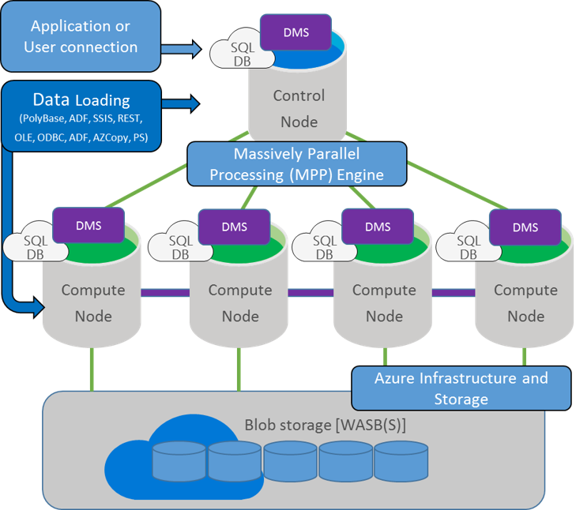
SQL Data Warehouse
SQL Data Warehouse combines the SQL Server relational database with Azure cloud scale-out capabilities, using a massively parallel processing (MPP) architecture
Scale beyond any single system by using shared-nothing storage and processing units
Data is stored in Premium locally redundant storage
Requests processed by control node, optimized and passed to the compute nodes to work in parallel
Control node looks like / powered by SQL Database
Translates T-SQL to parallel work
Pay only for scaled out CPU work and blob storage
Notes:
https://docs.microsoft.com/en-us/azure/sql-data-warehouse/sql-data-warehouse-overview-what-is

Slide 16
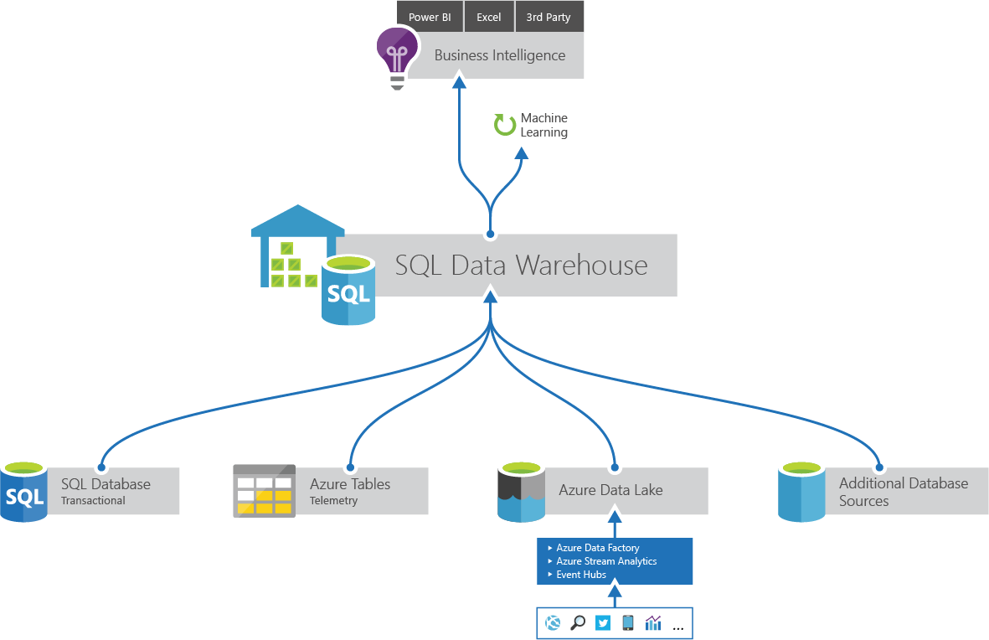
SQL Data Warehouse - DWU
Allocation of resources is measured in Data Warehouse Units (DWUs)
Metric designed to scale linearly
Scan/Aggregation: standard data warehousing query that scans large number of rows and then performs a complex aggregation
I/O and CPU intensive operation
Load: measures ability to ingest data into the service using PolyBase to load data set from Azure Blob storage
stress network and CPU
Create Table As Select: measures the ability to copy a table
CPU, IO and network intensive operation

Slide 17
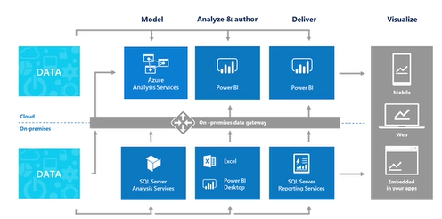
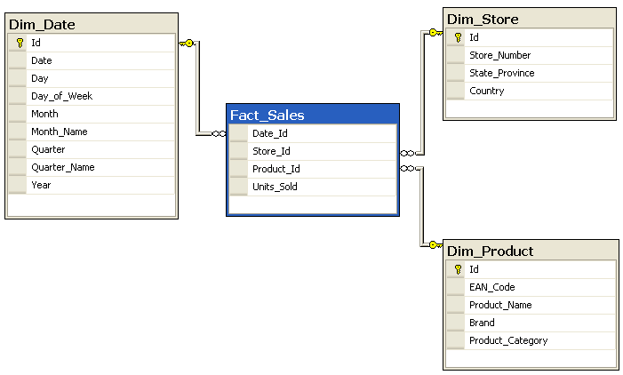
Azure Analysis Services
Build a BI Semantic Model of data
“Semantic” in the context of data warehouses means “from the user’s perspective”
Sits between the data source and the end user experience
Integrate data from multiple data sources
Reporting and dashboards, such as Power BI
Tabular Model
xVelocity/Vertipaq in-memory analytics engine
4 – 15 factor compression
Design star/snowflake schema
Fact tables referencing dimension table
Aggregate up and drill down dimensions
Billing is cache size and query processing units
Notes:
http://sqlmag.com/sql-server-analysis-services/starting-your-modeling-career-analysis-services-tabular-models-part-1

Slide 18
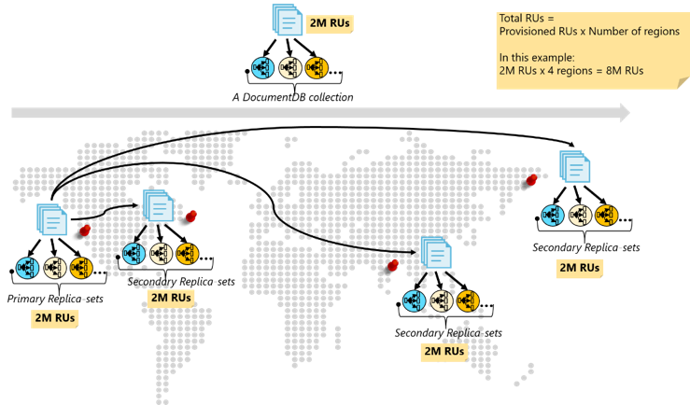
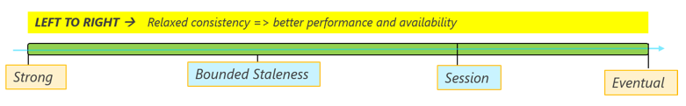
DocumentDB
DocumentDB is a fully managed NoSQL database service built for fast and predictable performance, high availability, elastic scaling, global distribution, ease of development with rich, familiar low latency SQL query capabilty
Fully managed and elastic
Data stored on SSD for low predictable latencies
Ad hoc queries with familiar SQL syntax
JavaScript used for logic as stored procedures, triggers, and user defined functions
Multi-region replication with consistency models:
Strong: write only visible after committed durably by majority quorum of replicas
Bounded staleness: define read lag by version ot time interval
Session: client baserd monotonic reads, monotonic writes
Eventual consistency: replicas within group will eventually converge
Notes:
https://docs.microsoft.com/en-us/azure/documentdb/documentdb-distribute-data-globally

Slide 19
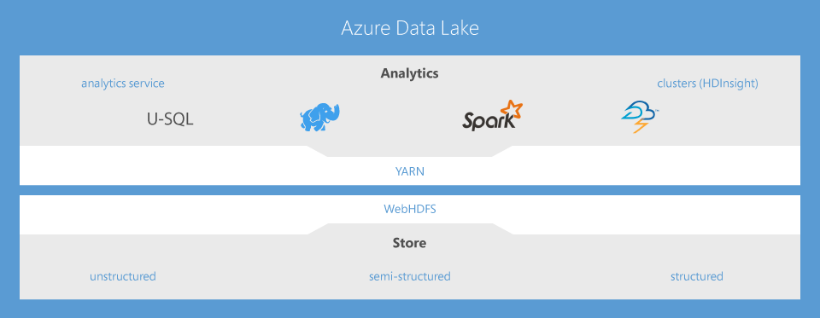
Azure Data Lake
Store and analyse petabyte-size files and trillions of objects
Develop massively parallel programs with simplicity
Enterprise-grade security, auditing, and support
Start in seconds, scale instantly, pay per job

Slide 20
Data Lake Store
Azure Data Lake Store is a hyper-scale repository for big data analytic workloads, enabling you to capture data of any size, type, and ingestion speed in one single place for operational and exploratory analytics
Apache Hadoop file system compatible with Hadoop Distributed File System (HDFS)
Works with the Hadoop analytic frameworks such as MapReduce or Hive
Exposed WebHDFS-compatible REST interface for applications
Unlimited storage, petabyte files
No limits on account sizes, file sizes, or the amount of data
Performance-tuned for big data analytics
spreads parts of a file over a number of individual storage servers
Secure data
Authentication, access control and encryption via AAD

Slide 21
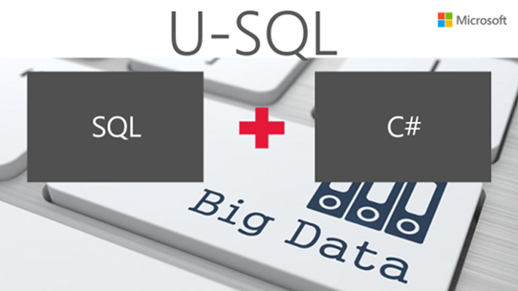
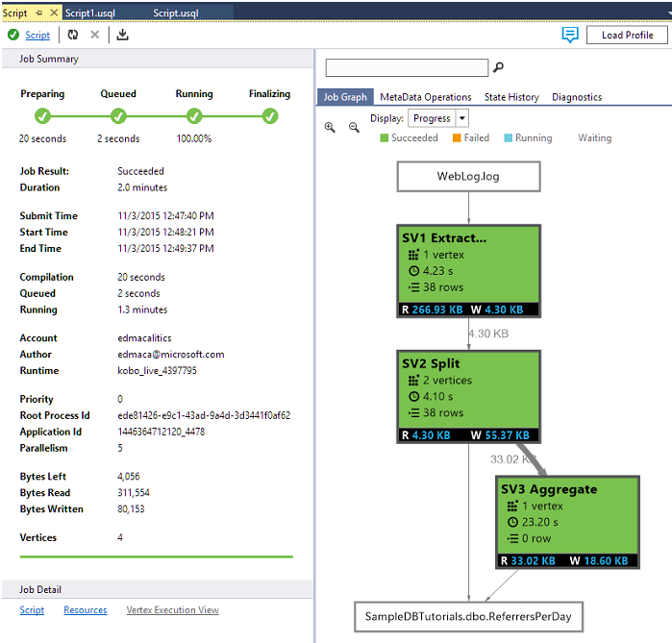
Data Lake Analytics
Makes big data analytics easy, letting you focus on writing, running and managing jobs, rather than operating distributed infrastructure
U-SQL - query language that extends the familiar, simple, declarative nature of SQL with the expressive power of C#
Built on the same distributed runtime that powers big data systems inside Microsoft
Deep integration with Visual Studio
Familiar tools to run, debug, and tune code
Visualizations of U-SQL jobs let you see how your code runs at scale, to identify performance bottlenecks and optimize costs
Built on YARN for massive scale
Notes:
https://azure.microsoft.com/en-us/blog/behind-the-scenes-of-azure-data-lake-bringing-microsoft-s-big-data-experience-to-hadoop/

